Slide 1

Information Security Policies, Standards and Procedures

Slide 2
Why Policies?
To Protect Information Assets
To Address Organizational Risk
Frame work for an Organization
Policies are foundation and Framework for an Organization.

Slide 3
What’s a Policy, Standard or Procedure
A policy is typically a document that outlines specific requirements or rules that must be met. In the information/network security realm, policies are usually point-specific, covering a single area. For example, a “Password " policy would cover the rules and regulations for appropriate use of passwords within an organization. An example – a typical password policy would be length of 8 characters and a combination of alpha numeric.
A standard is typically collections of system-specific or procedural-specific requirements that must be met by everyone. For example, you might have a standard that describes how to harden a Linux Server for placement on an external (DMZ) network. People must follow this standard exactly if they wish to install a Linux Server on an external network segment.
A Procedure is typically collections of procedural steps that are used to implement a security policy. For example, you might have a procedures that describes how to implement a password policies on a specific platform such as linux or windows server.

Slide 4
Approach
Risk Assessment
Identify all the assets that we are trying to protect.
Identify all the vulnerabilities and threats and the likeliness of the threats happening.
Decide which measures which will protect the assets in a cost-effective manner.
Write the Policy.
Communicate findings and results to the appropriate parties.
Monitoring and review the process continuously for improvement.

Slide 5
ISO 17799
ISO 17799 provides a comprehensive set of guidelines and controls comprising best practices in information security whereby it can be used as a basis to develop security policy.
The ISO 17799 defines 127 security controls which are grouped into 10 sections can be used as a security checklist to assist us in defining our policy.
However, not all of the controls defined will be relevant to the organization.

Slide 6
Typical Set of Policies and Organization will include
Information Governance
Information Security Policy
Change Control
Systems Development life Cycle Development
Operational Policy
Back-Up and Recovery
Networking
External
Internal
End User Computing
NOTE THIS IS NOT ALL INCLUSIVE

Slide 7
Structure of a Policy
Purpose – What is the reason – i.e. To Established Uniform Passwords Policies for the entire organization
Policy Statement – What is the actual policy – i.e. – Passwords will be use to authenticate access to all of XYZ Systems.
Scope - Who and Where does the policy apply to – i.e. This policy is applicable to all systems being utilized at XYZ Systems
Responsibility – The person/s in the organization who is the owner or responsible for the policy. i.e – Information Security is responsible for the implementation of the password standards.
Compliance – The person or group that will ensure compliance with the policy. i.e. Internal audit will performed periodic audits to ensure compliance.

Slide 8
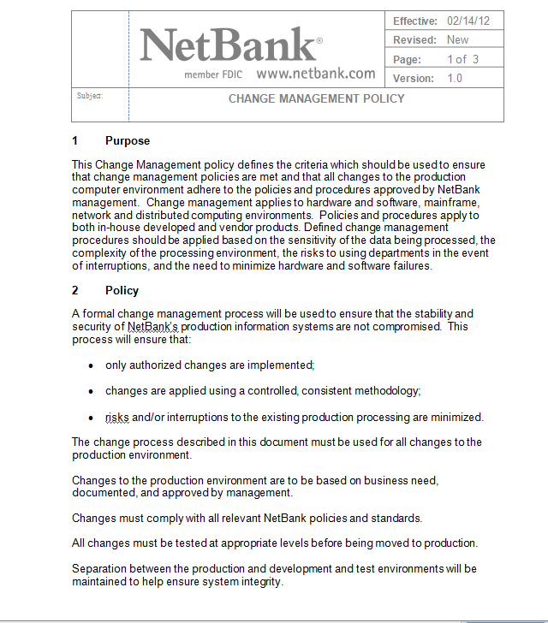
Sample Policy

Slide 9
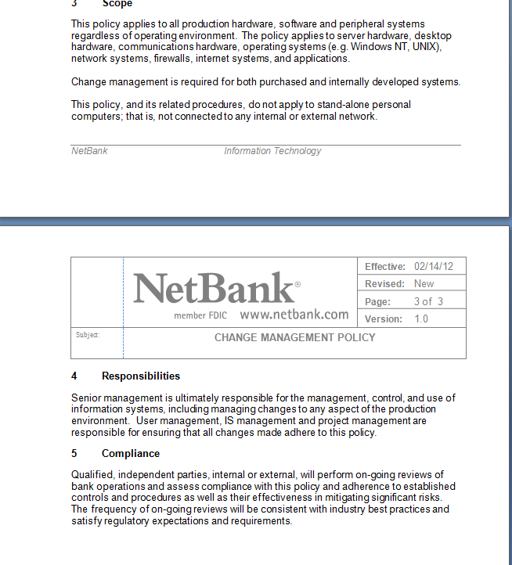
Sample Policy Continue

Slide 10
Policy Area’s

Slide 11
Information Governance
Sets the tone for the IT Organization
Sets out the Roles and Responsibilities
Requirements for a steering committee
Vision and Strategy
Information Technology Architecture
Risk Management of Technology
Ethics and Code of Conduct
Compliance

Slide 12
Information Security Policy
Sets the Overall Frame Work
Policy Statement
Usually compose of several underlying policies
Risk Assessment Standards
Minimum Security Baselines

Slide 13
One Security Model

Slide 14
Minimum Security Baselines
Requires an organization to have a minimum set of security policies.
Typical Components
Identification
Authentication
Authorization
Accountability and Tracking
Security Maintenance
Physical Security
Logging/Tracking

Slide 15
Identification and Authentication
User ID’s Passwords
Length
Complexity
Expiration
History
Lockout
Two Factor Authentication
Part I What is known
Part II What I have

Slide 16
Change Controls
Policy consists three critical pieces
Authorization - by end a user to authorized a change to the program or infrastructure.
Testing of the Change
Approval
Approve the testing of change (if required)
Approval to make the change and implement

Slide 17
Change Control
One of the most Critical Policies with an organization
Changes to the IT environment are controlled and authorized by Management.
Composed of two parts
Applications
Infrastructure
Policy consists of Authorization

Slide 18
Physical Security
Physical Security of Premises
Alarms
Video
Card Readers
Who is allowed into the premises
Only operational support should be granted access to the data center.
Environmental Controls
Fires Detection
Water Detection
Controlled Environment

Slide 19
Segregation of Duties
Incompatible Job Functions
Example
Developers cannot have access to the Production System.
Who ever approves a change to the system cannot implement that changed

Slide 20
Password Security Policy
Secure
Must Password Change every 30 days
Password Length > 8 characters
Must Change upon initial Log-in
Time – Out after 15 minutes of inactivity
Lock-out after 3 attempts
Medium
Password must be Changed every 90 days
Password Length < 6 characters
No change at initial log-in
No Lock - Out

Slide 21
Windows Security Policy
Determine on how windows security in implement with in the Domain –
Critical Concepts and Areas:
Domain Vs Local Policy
Account Polices
Audit policy
Security Options

Slide 22
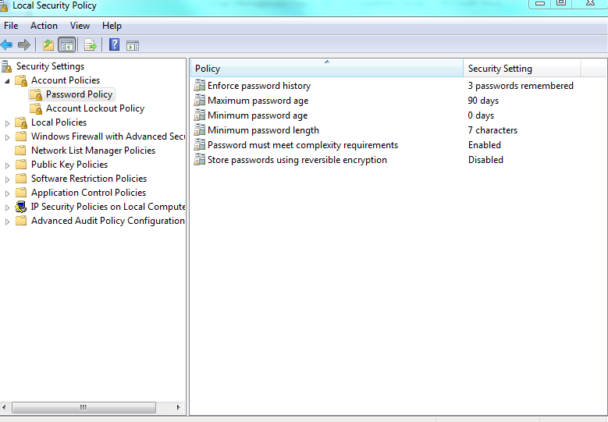
Windows Account Policy

Slide 23
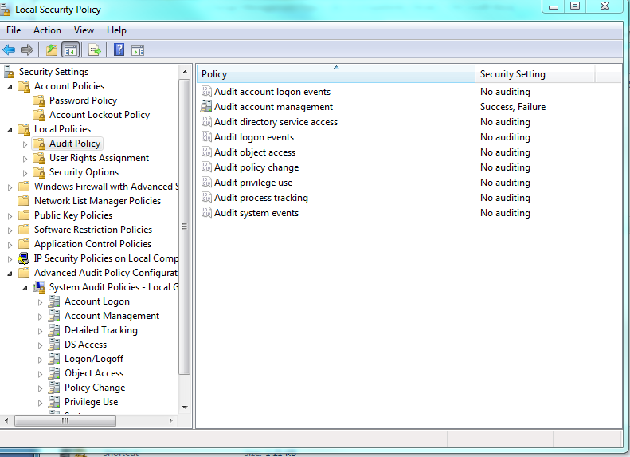
Windows - Audit Policy

Slide 24
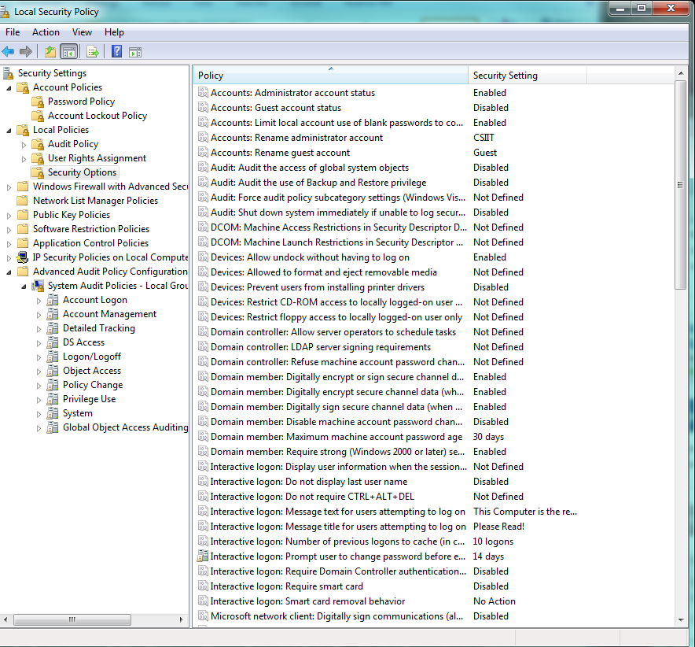
Windows - Security Options

Slide 25
Security Policies Audit Issues
Lack of Risk Assessment to guide the development and Implementation
Policies do not cover the Risk or meet Regulatory Requirements
Policies are written but not Implemented !

